Slide 1

ARTIFICIAL INTELLIGENCE AND NEURAL NETWORKS
ADVANCED DATA SCIENCE TRAINING I
data-action-lab.com

Slide 2
OUTLINE
A Brief History of A.I.
Basics of Neural Networks
Case Study: Japanese Pharmacy Chain
Deep Learning

Slide 3
LEARNING OBJECTIVES
Awareness of some highlights of the recent history of A.I. research
Able to define, generally, what an artificial neural network is
Understanding of the role of back propagation in training neural nets
Awareness of some strengths and limitations of neural networks
Able to define, in very general terms, the concept of ‘deep learning’

Slide 4
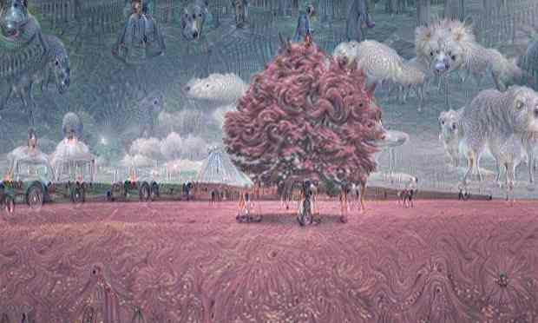
[Yes, Androids Do Dream of Electric Sheep, The Guardian UK]

Slide 5
A Brief History of A.I.
Artificial intelligence and neurAL NETWORKS
Q: How many legs does a cat have if you call the tail a leg?
A: Four. Calling the tail a leg doesn’t make it a leg.
(old riddle, attributed to Abraham Lincoln)

Slide 6
Headlines
“AlphaGo vanquishes world’s top Go player, marking A.I.’s superiority over human mind” [South China Morning Post, May 27, 2017]
“A Japanese A.I. program just wrote a short novel, and it almost won a literary prize” [Digital Trends, March 23, 2016]
“Elon Musk: Artificial intelligence may spark World War III” [CNET, September 4, 2017]
“A.I. hype has peaked so what’s next?” [TechCrunch, September 30, 2017]

Slide 7
What is Artificial Intelligence (A.I.)?
[D. Hoftsadter, Gödel, Escher, Bach, 1979]
What are the essential qualities and skills of an intelligence?
provides flexible responses in various scenarios
takes advantage of lucky circumstances
makes sense out of contradictory messages
recognizes the relative importance of a situation’s elements
finds similarities between different situations
draws distinctions between similar situations
comes up with new ideas from scratch or by re-arranging previous known concepts

Slide 8
DISCUSSION
Do you think that Hofstadter’s definition is still valid?

Slide 9
What is Artificial Intelligence?
[Artificial Intelligence, Wikipedia]
A.I. research is defined as the study of intelligent agents: any device that perceives its environment and takes actions that maximize its chance of success at some goal.
Examples
Expert Systems
TurboTax, WebMD, technical support, insurance claim processing, air traffic control, etc.
Decision-Making
Deep Blue, auto-pilot systems, ”smart” meters, etc.
Natural Language Proc.
machine translation, Siri, named-entity recognition, etc.
Recommenders
Google, Expedia, Facebook, LinkedIn, Netflix, Amazon, etc.
Content generators
music composer, novel writer, animation creator, etc.
Classifiers
facial recognition, object identification, fraud detection, etc.

Slide 10
Historical Timeline
[K.A. Smith, J.N.D. Gupta, Neural Networks in Business, 2000]
Pre-Historic Times
Babbage’s Analytic Engine (1834)
Turing’s Brain as Computer Paradigm (1936)
Turing Test (1950): can a computer fool a human observer (The Imitation Game)
Initial Optimism (AI will be solved by 1980s)
Dartmouth Summer Research Project on AI and NN (1956)
Perceptrons (1957–1966)
Self-Organizing Maps (1976)

Slide 11
Historical Timeline (TL;DR)
???
Deep Learning and Big Data
Initial Optimism
Revival
Modern A.I.
???
1st A.I. Winter
2nd A.I. Winter
1950s 1960s 1970s 1980s 1990s 2000s 2010s 2020s
Turing Test
5th Generation Project
Human Brain Project
???
Dartmouth Summer
Backpropagation
Deep Blue
Stanley

Slide 12
DISCUSSION
Where do you think A.I. is heading? 3rd A.I. Winter or onto bigger and better things?
How can businesses and governments prepare themselves for either eventuality?

Slide 13
Neural Network Basics
ARTIFICIAL INTELLIGENCE AND NEURAL NETWORKS
“Neural networks blow all previous techniques out of the water in terms of performance, but given the existence of adversarial examples, it shows we really don't understand what's going on.”
(D. Gershgorn, Quartz)

Slide 14
Neural Networks in a Nutshell
A trained Artificial Neural Network (ANN) is a function that maps inputs to outputs in a useful way:
receives input(s)
computes values
provides output(s)
ANNs use a Swiss-army-knife approach to things (plenty of options, but it’s not always clear which one should be used).
The user does not need to decide much about the function or know much about the problem space in advance (quiet model).

Slide 15
Neural Networks in a Nutshell
Algorithms allow ANNs to learn (i.e. generate the function and its internal values) automatically.
ANNs can be used for:
supervised learning (multi-layered feedforward neural networks)
unsupervised learning (self-organizing maps)
reinforcement learning.
Technically, the only requirement is the ability to minimize a cost function (optimization).

Slide 16
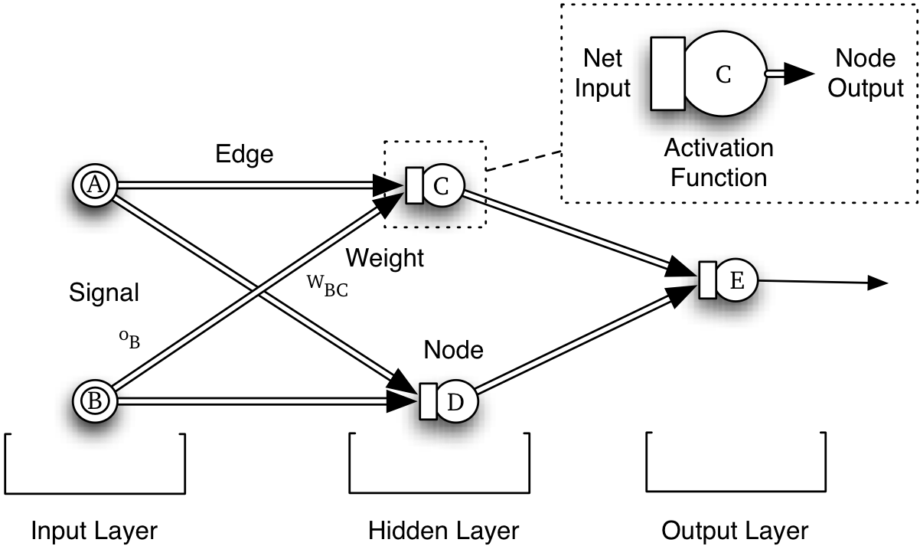


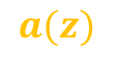


Network Topology and Terminology
Net Input
Node Output
$$z$$
$$a(z)$$
Edge
Activation Node
Weight
Signal
$$w$$
$$x$$
Output
$$\hat{y}$$
Node
Input Layer
Hidden Layer(s)
Output Layer

Slide 17

Network Topology and Terminology
Network Topology and Terminology
Net Input
Node Output
$$z$$
$$a(z)$$
Edge
Activation Node
Weight
Signal
$$w$$
$$x$$
Output
$$\hat{y}$$
Node
Input Layer
Hidden Layer(s)
Output Layer

Slide 18


Network Topology and Terminology
Network Topology and Terminology
Net Input
Node Output
$$z$$
$$a(z)$$
Edge
Activation Node
Weight
Signal
$$w$$
$$x$$
Output
$$\hat{y}$$
Node
Input Layer
Hidden Layer(s)
Output Layer

Slide 19
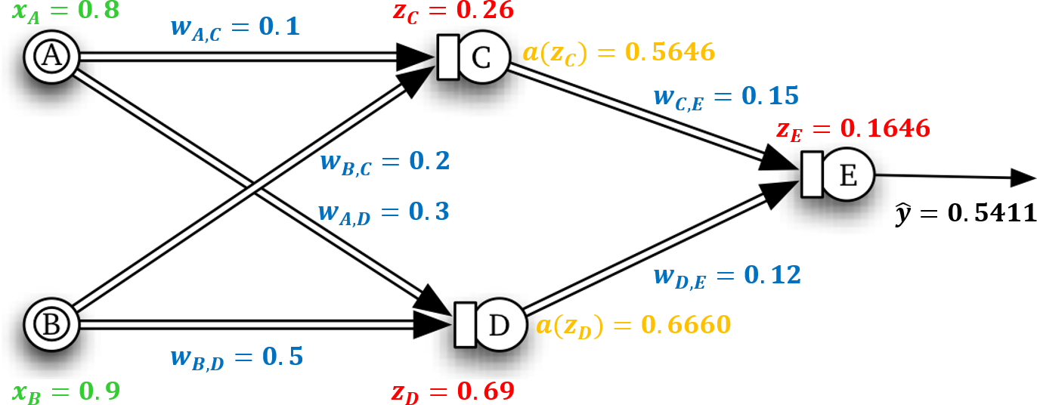
Feed Forward Network
?

Slide 20
Feed Forward Network
Feed Forward Network
?

Slide 21
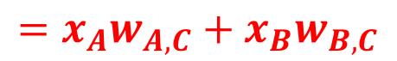
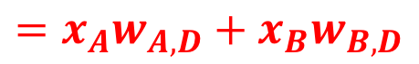
Feed Forward Network
Feed Forward Network
$$=x_{A}w_{A,C}+x_{B}w_{B,C}$$
?
$$=x_{A}w_{A,D}+x_{B}w_{B,D}$$

Slide 22


Feed Forward Network
Feed Forward Network
$$=x_{C}$$
?
$$=x_{D}$$

Slide 23
Feed Forward Network
Feed Forward Network
$$=x_{C}$$
?
$$=x_{D}$$

Slide 24
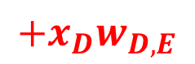
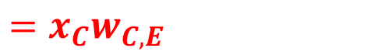
Feed Forward Network
Feed Forward Network
$$=x_{C}$$
$$=x_{C}w_{C,E}$$
$$+x_{D}w_{D,E}$$
?
$$=x_{D}$$

Slide 25
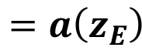
Feed Forward Network
Feed Forward Network
$$=a\left(z_{E}\right)$$

Slide 26
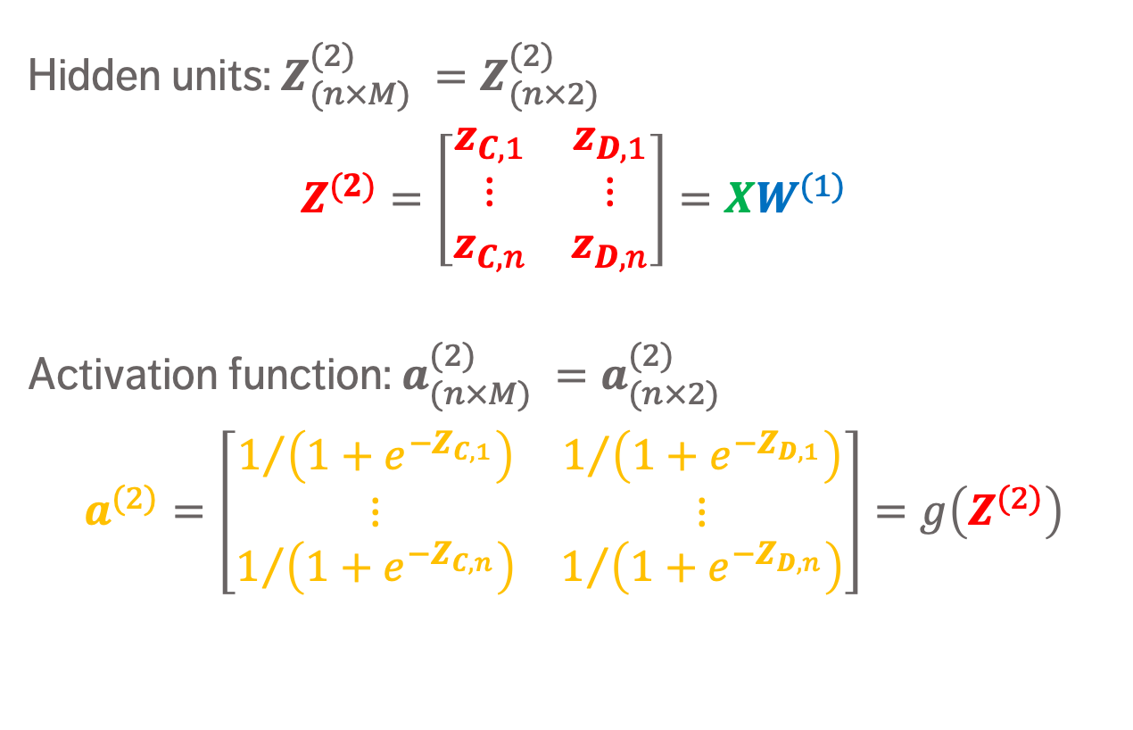
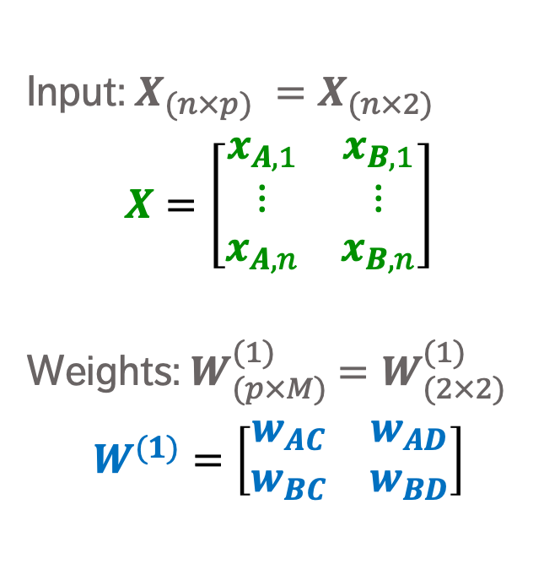
ANN in Matrix Notation – INput to Hidden Layer
Input: $X_{(n×p) }=X_{(n×2) }$
$$X=\left[\begin{matrix}x_{A,1} & x_{B,1} \\ ⋮ & ⋮ \\ x_{A,n} & x_{B,n}\end{matrix}\right]$$
Weights:${ W}_{(p×M) }^{(1)}=W_{(2×2) }^{(1)}$
$$W^{(1)}=\left[\begin{matrix}w_{AC} & w_{AD} \\ w_{BC} & w_{BD}\end{matrix}\right]$$
Hidden units: $Z_{(n×M) }^{(2)}=Z_{(n×2) }^{(2)}$
$$Z^{(2)}=\left[\begin{matrix}z_{C,1} & z_{D,1} \\ ⋮ & ⋮ \\ z_{C,n} & z_{D,n}\end{matrix}\right]=XW^{(1)}$$
Activation function: $a_{(n×M) }^{(2)}=a_{(n×2) }^{(2)}$
$$a^{(2)}=\left[\begin{matrix}1/{\left(1+e^{−Z_{C,1}}\right)} & 1/{\left(1+e^{−Z_{D,1}}\right)} \\ ⋮ & ⋮ \\ 1/{\left(1+e^{−Z_{C,n}}\right)} & 1/{\left(1+e^{−Z_{D,n}}\right)}\end{matrix}\right]=g\left(Z^{(2)}\right)$$

Slide 27
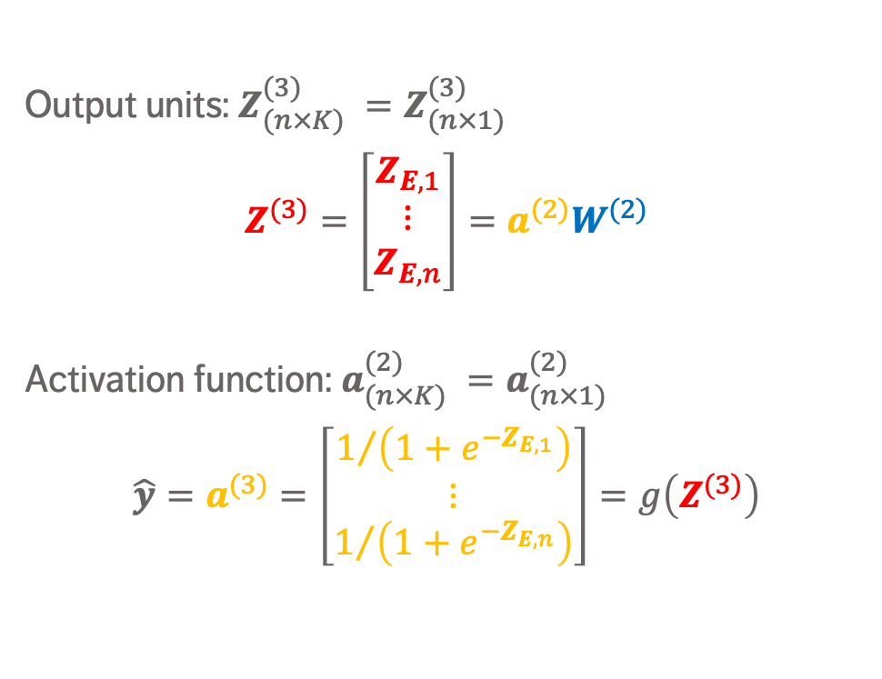
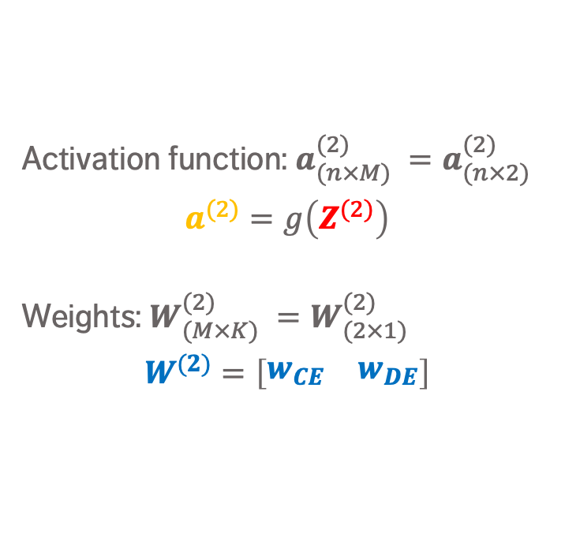
ANN in Matrix Notation – Hidden to Output Layer
Activation function: $a_{(n×M) }^{(2)}=a_{(n×2) }^{(2)}$
$$a^{(2)}=g\left(Z^{(2)}\right)$$
Weights: $W_{(M×K) }^{(2)}=W_{(2×1) }^{(2)}$
$$W^{(2)}=\left[\begin{matrix}w_{CE} & w_{DE}\end{matrix}\right]$$
Output units: $Z_{(n×K) }^{(3)}=Z_{(n×1) }^{(3)}$
$$Z^{(3)}=\left[\begin{matrix}Z_{E,1} \\ ⋮ \\ Z_{E,n}\end{matrix}\right]=a^{(2)}W^{(2)}$$
Activation function: $a_{(n×K) }^{(2)}=a_{(n×1) }^{(2)}$
$$\hat{y}=a^{(3)}=\left[\begin{matrix}1/{\left(1+e^{−Z_{E,1}}\right)} \\ ⋮ \\ 1/{\left(1+e^{−Z_{E,n}}\right)}\end{matrix}\right]=g\left(Z^{(3)}\right)$$

Slide 28
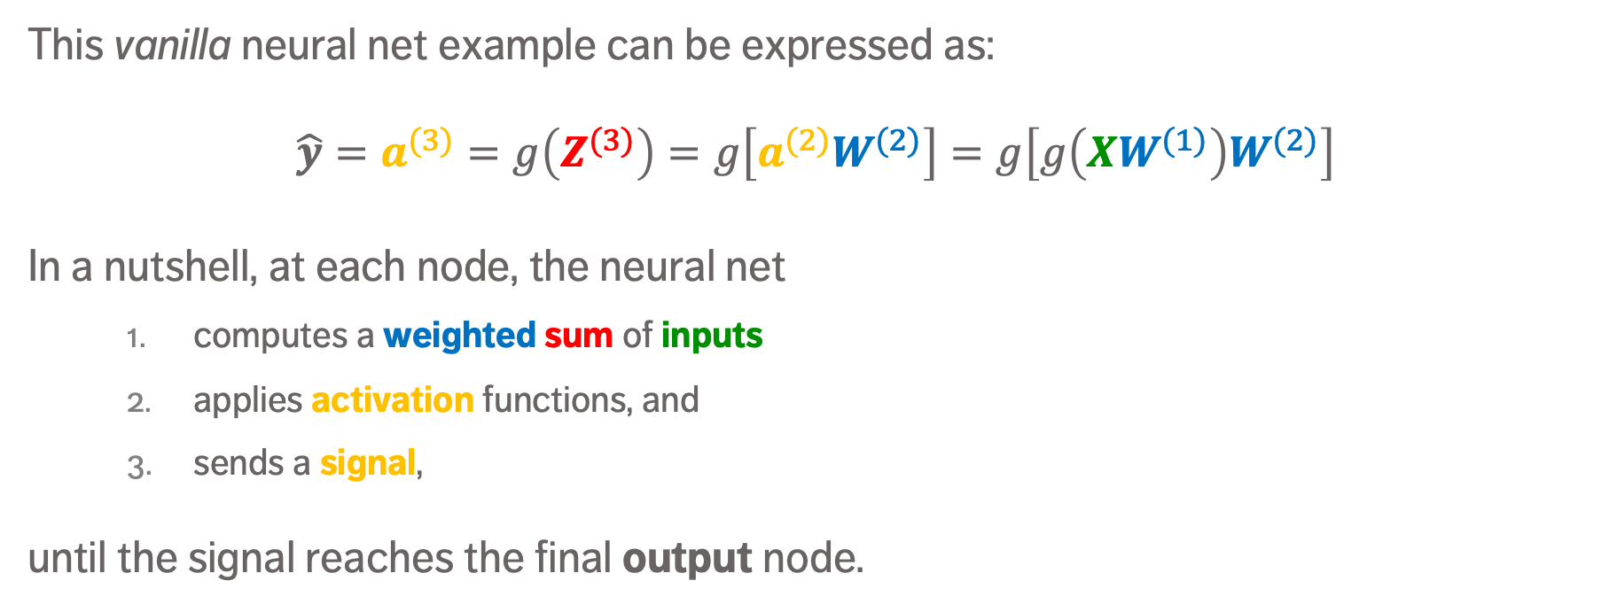
ANN in Matrix Notation
This vanilla neural net example can be expressed as:
$$\hat{y}=a^{(3)}=g\left(Z^{(3)}\right)=g\left[a^{(2)}W^{(2)}\right]=g\left[g\left(XW^{(1)}\right)W^{(2)}\right]$$
In a nutshell, at each node, the neural net
computes a weighted sum of inputs
applies activation functions, and
sends a signal,
until the signal reaches the final output node.

Slide 29
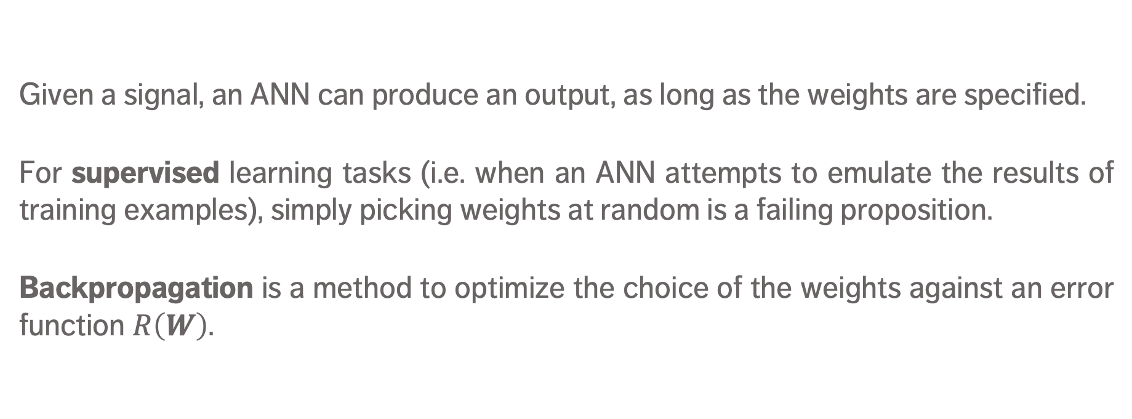
Backpropagation – ANN Training
Given a signal, an ANN can produce an output, as long as the weights are specified.
For supervised learning tasks (i.e. when an ANN attempts to emulate the results of training examples), simply picking weights at random is a failing proposition.
Backpropagation is a method to optimize the choice of the weights against an error function $R\left(W\right)$.

Slide 30
Backpropagation Objective

Slide 31
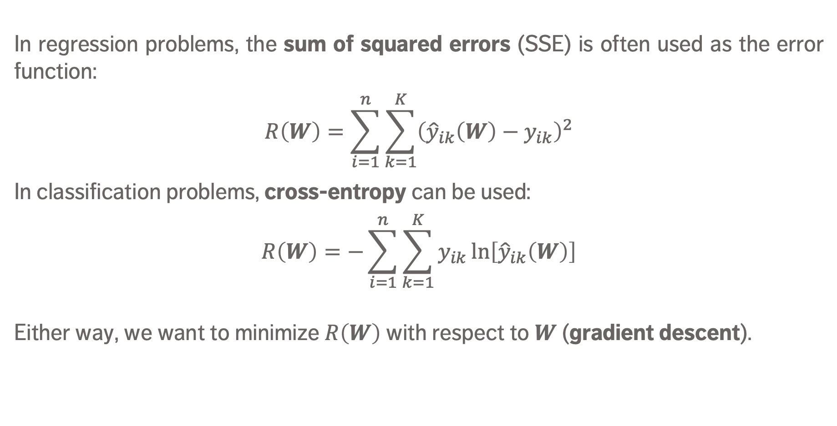
Backpropagation – Error Function
In regression problems, the sum of squared errors (SSE) is often used as the error function:
$$R\left(W\right)=\sum_{i=1}^{n}{\sum_{k=1}^{K}{{\left({\hat{y}}_{ik}\left(W\right)−y_{ik}\right)}^{2}}}$$
In classification problems, cross-entropy can be used:
$$R\left(W\right)=−\sum_{i=1}^{n}{\sum_{k=1}^{K}{y_{ik}\ln\left[{\hat{y}}_{ik}\left(W\right)\right]}}$$
Either way, we want to minimize $R\left(W\right)$ with respect to $W$ (gradient descent).

Slide 32
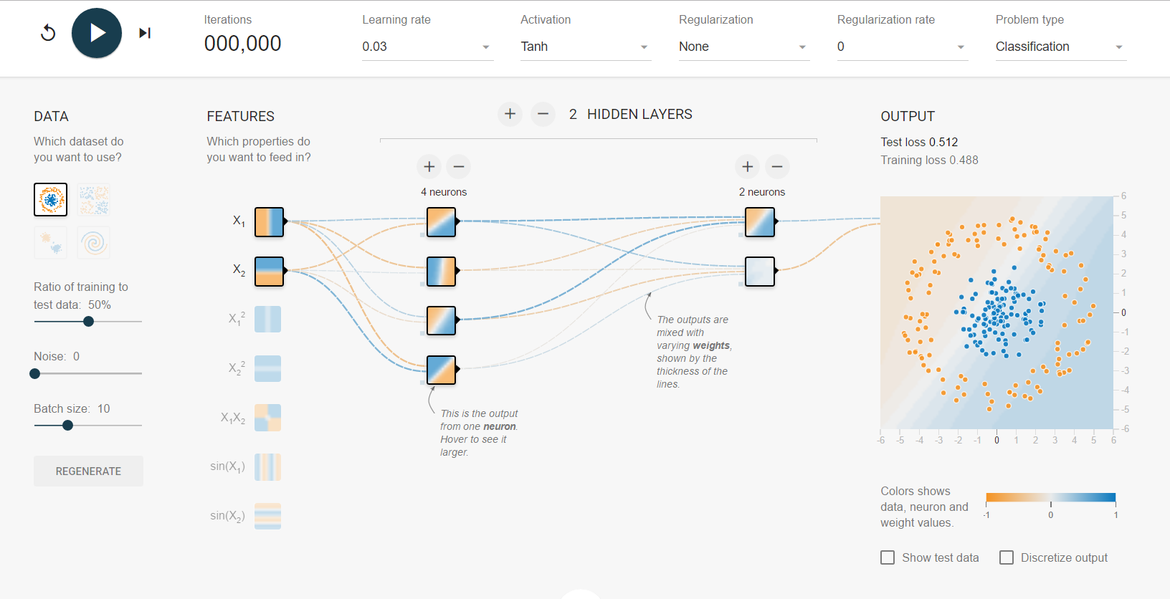
A Neural Network Playground
[D. Smilkov, S. Carter, TensorFlow.org]

Slide 33
Strengths
ANNs can be quite accurate when making predictions – better than other algorithms with a proper set up.
ANNs often work when other things fail:
when the relationship between attributes is complex
when there are a lot of dependencies/nonlinear relationships
messy, highly connected inputs (images, text and speech)
non-linear classification
ANNs are relatively easy to set up (with available packages).
ANNs degrade gracefully (important in robotics).

Slide 34
Limitations
ANNs are relatively slow (creating and using) and prone to overfitting (may require large/diverse training set).
ANNs usually do not provide good interpretation (unlike decision trees or logistic regression, say). Can you live with that?
No algorithms for selecting the optimal network topology.
Even when they do perform better than other options, ANNs may not perform that much better due to No Free-Lunch Theorems; and they’re susceptible to various forms of adversarial attacks.

Slide 35
DISCUSSION
The biggest challenge (to our minds) is to overcome the black box nature of ANNs. How important is it to you and your organization to be able to explain data-driven decisions?

Slide 36
Neural Networks VIDEOS (BRILLIANT!)
Neural Networks Demystified, Welch Labs https://www.youtube.com/watch?v=bxe2T-V8XRs (first in the series)
Learning to See, Welch Labs https://www.youtube.com/watch?v=i8D90DkCLhI (first in the series)
Neural Networks, 3 Blue 1 Brown https://www.3blue1brown.com/videos/2017/10/9/neural-network

Slide 37
Case Study: Japanese Pharmacy Chain
ARTIFICIAL INTELLIGENCE AND NEURAL NETWORKS
A Neural Network Application to Identify High-Value Customers for a Large Retail Store in Japan
(Ip, E., Johnson, J., Yada, K., Hamuro, Y., Katoh, N., Cheung, S. [2002], Neural Networks in Business: Techniques and Applications, Smith, K., Gupta, J. (eds), IRM Press)

Slide 38
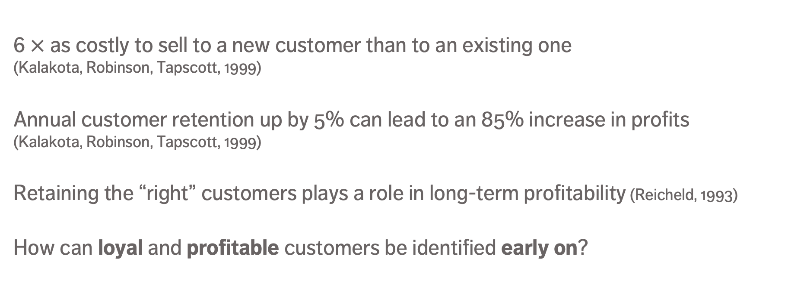
Context
6 $×$ as costly to sell to a new customer than to an existing one (Kalakota, Robinson, Tapscott, 1999)
Annual customer retention up by 5% can lead to an 85% increase in profits (Kalakota, Robinson, Tapscott, 1999)
Retaining the “right” customers plays a role in long-term profitability (Reicheld, 1993)
How can loyal and profitable customers be identified early on?

Slide 39
Context
Japanese drugstore chain Pharma (annual revenues ¥70B), 1300 retail stores, 2.3 million customers
Stores may use their own names, but operate under a central information system, which collects transaction and customer information since the early 1990s
Sales campaign information, customized coupons, free samples mailed to target group (i.e. loyal, high-value customers)

Slide 40
Neural Network Learning Flow
Fine-Tune Model
Training Data
Train Neural Network Model
Apply NN Model to Test Data
Assess NN Model Performance
Testing Data

Slide 41
Data
114,069 customers who made purchases during a 1-yr period
Customer value measured using
frequency of visit (1 – 5 scale)
profitability per visit (1 – 5 scale)
High-value customers (HVC): (4,5), (5,4), (5,5), making up 10.6% of observations
HVCs generate 52.5% of profits, 38.4% of revenues

Slide 42
Data
Target variable: customer value
Input variables: total number of categories purchased, profit per visit, # of units purchased per visit, # visits, purchase of:
All variables were scaled from 0 – 1:
paper product
detergent
eye drops
kitchen cleaner
bottled supplement
hair care products
fabric softener
household cleaner
toothpaste
cold medicine

Slide 43
Data
Learning set: 104,069 observations (selected randomly)
Training/Testing set ratio: 70-to-30
Validation set: remaining 10,000 observations
Calibration metrics: predictive accuracy, overall accuracy
predictive accuracy = # correctly predicted HVCs / # HVCs
overall accuracy = # correctly predicted class / # customers

Slide 44
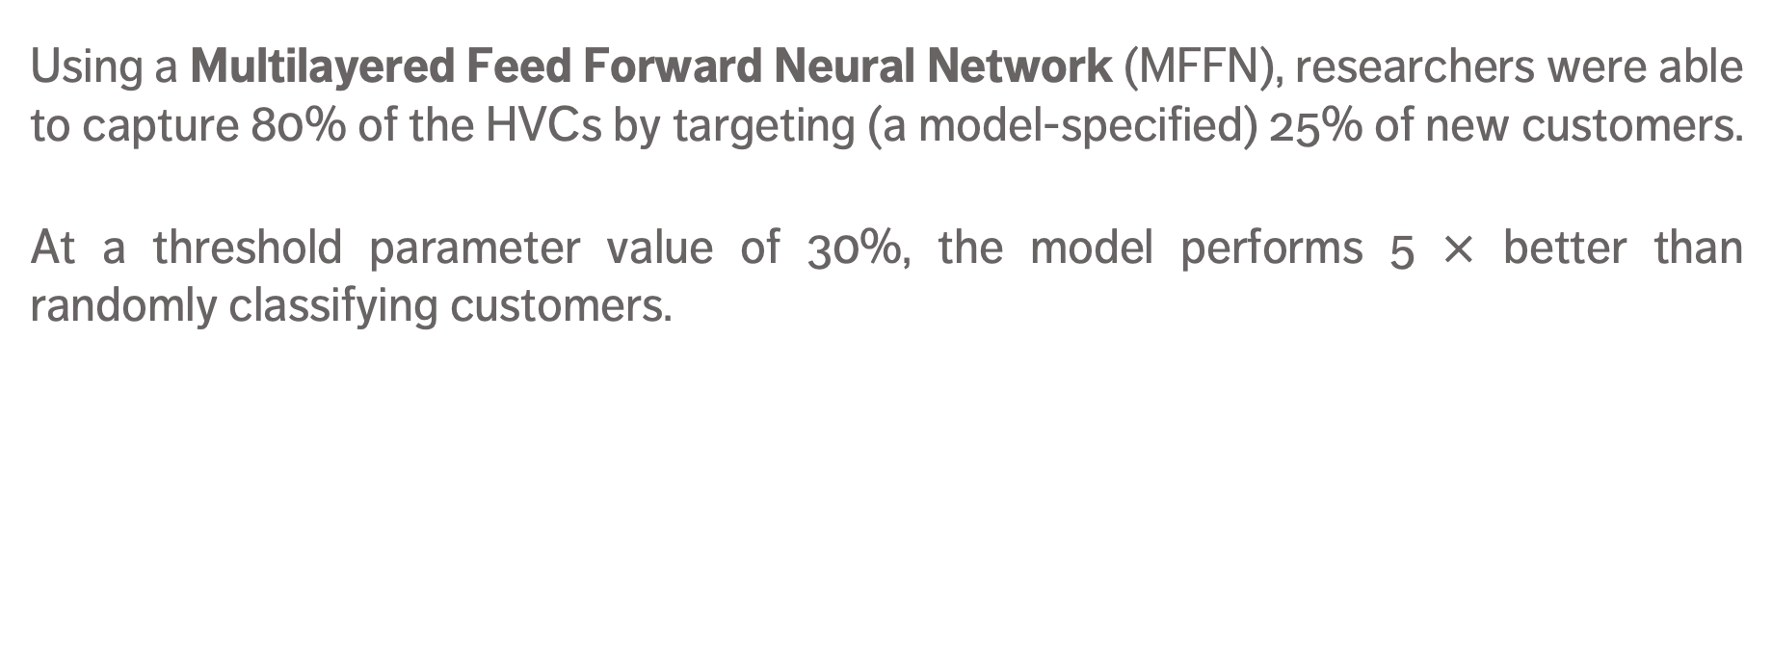
Results
Using a Multilayered Feed Forward Neural Network (MFFN), researchers were able to capture 80% of the HVCs by targeting (a model-specified) 25% of new customers.
At a threshold parameter value of 30%, the model performs 5 $×$ better than randomly classifying customers.
Dataset | Training | Validation
Predictive Accuracy | 55.6% | 57.4%
Overall Accuracy | 90.6% | 91.2%
% Classified as HVC | 10.6% | 10.3%

Slide 45
DISCUSSION
Do you think the results of this case study are transferrable to other domains?
Would a similar MFFN provide the same level of predictive power in Canada?

Slide 46
Deep Learning
ARTIFICIAL INTELLIGENCE AND NEURAL NETWORKS
“Humanity is on the verge of digital slavery at the hands of AI and biometric technologies. One way to prevent that is to develop inbuilt modules of deep feelings of love and compassion in the learning algorithms.”
(A. Ray)

Slide 47
Deep Learning Networks
Deep Learning networks are simply ANNs with a large number of hidden layers (and various types of nodes)
Types:
Convolution Neural Networks Handwritten digit recognition, 99.7% accuracy in 2013, Self-driving cars
Recurrent Neural Networks Natural language processing (speech recognition, machine translation, etc.)
Autoencoders
Restricted Boltzmann Machines BellKor’s Pragmatic Chaos, Netflix Prize, 2009

Slide 48
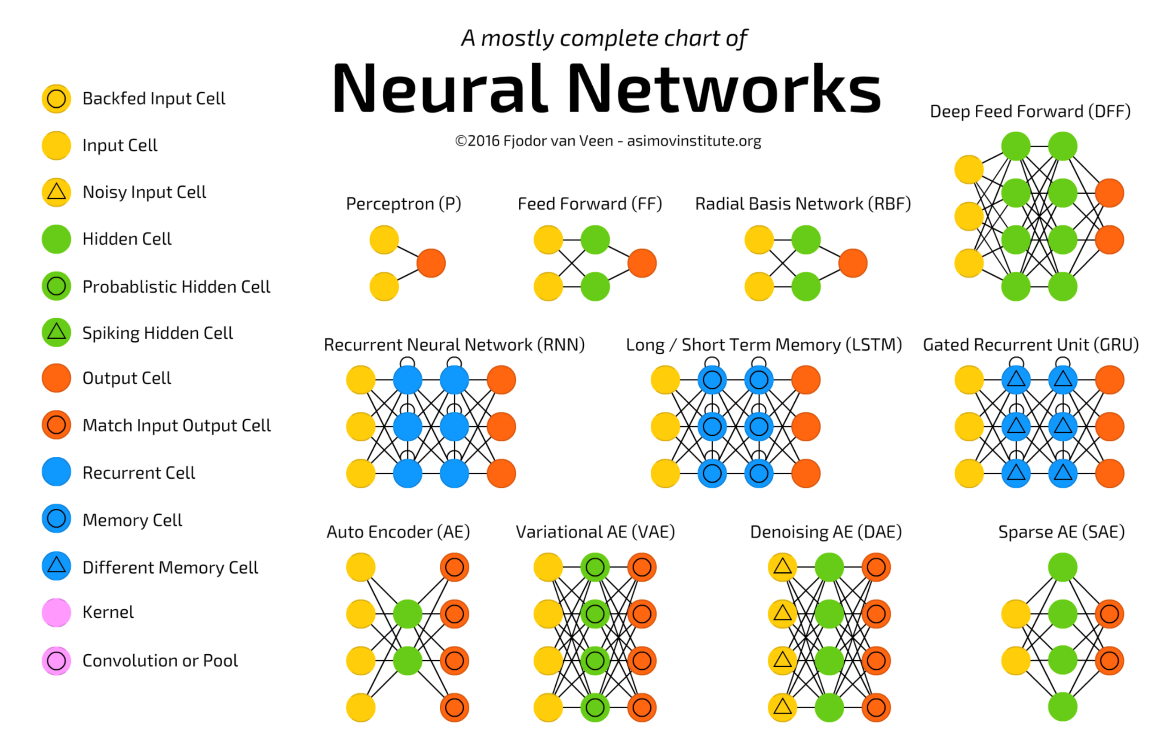
[Fjodor van Veen, Asimov Institute, 2016]

Slide 49
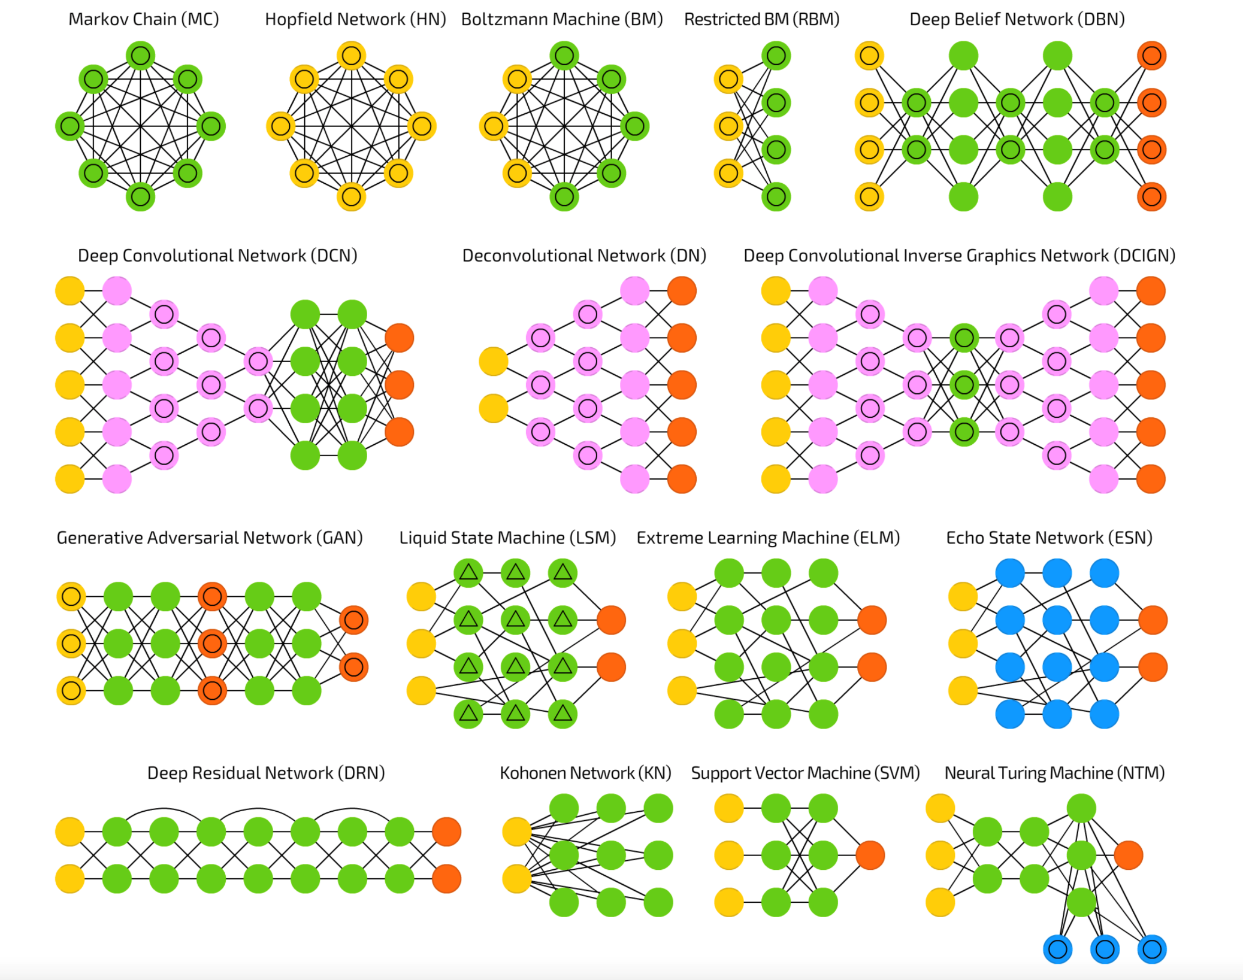
[Fjodor van Veen, Asimov Institute, 2016]

Slide 50
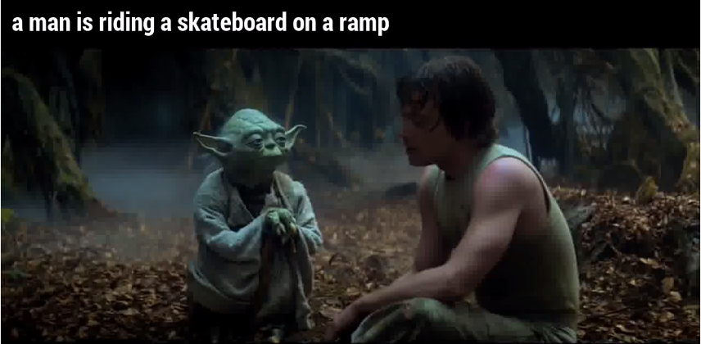
Limitations
[@samim, medium.com]
Require large, diverse, and correctly labeled training sets.
Accurate on average, but they can still be spectacularly wrong.
They can be “hacked” (NFL).
Humans don’t need that much labeled data to make decisions: so what’s really going on under the hood? (3rd AI Winter?)

Slide 51
Limitations
[@samim, medium.com]
Require large, diverse, and correctly labeled training sets.
Accurate on average, but they can still be spectacularly wrong.
They can be “hacked” (NFL).
Humans don’t need that much labeled data to make decisions: so what’s really going on under the hood? (3rd AI Winter?)

Slide 52
DISCUSSION
How do we align autonomous A.I. goals with human/cultural values?

Slide 53
SUPPLEMENTAL MATERIAL
ARTIFICIAL INTELLIGENCE AND NEURAL NETWORKS

Slide 54
Historical Timeline
First AI Winter (1974 – 1980)
High expectations but next to nothing to show for them
Lack of computing power, funding withdrawn
Revival
Japan’s Fifth Generation Project (1982 – 1992)
Defense Advanced Research Projects Agency funding (1983)
Backpropagation (1985)
1st IEEE Conference (1987)

Slide 55
Historical Timeline
Second AI Winter (1987 – 1993)
Expensive to maintain; massive funding cuts
Bad learners, not great with uncertainty
Japan’s FGP goals not met
Modern AI (1993 – 2001)
Huge leap in computing power
Deep Blue and “intelligent agents” paradigm

Slide 56
Historical Timeline
Deep Learning and Big Data (2001 – present)
Parallel computing power
Terabytes of data
Deep neural networks
Human Brain Project (10yr project, 1.3B USD, 2013 – 2023)
Self-driving vehicles?

Slide 57
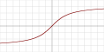
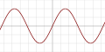
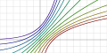
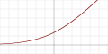
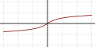
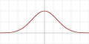

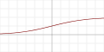



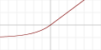

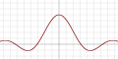
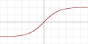
Activation Functions
[https://en.wikipedia.org/wiki/Activation_function]
There are many options: what effect(s) does the choice have, if any?

Slide 58
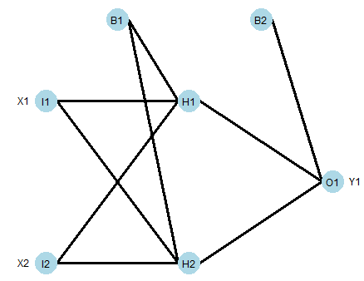
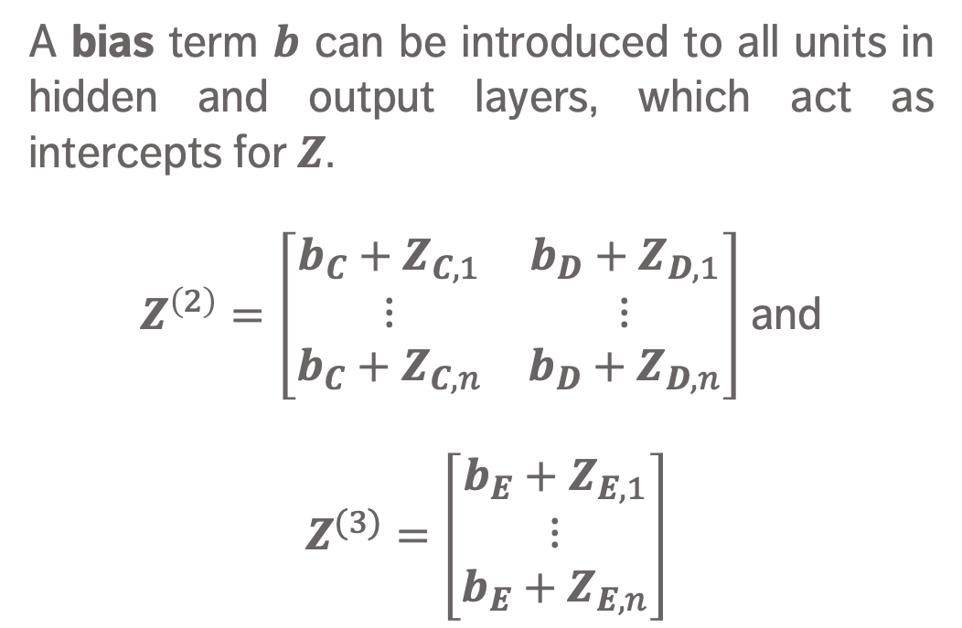
Bias
A bias term $b$ can be introduced to all units in hidden and output layers, which act as intercepts for $Z$.
$Z^{\left(2\right)}=\left[\begin{matrix}{b_{C}+Z}_{C,1} & {b_{D}+Z}_{D,1} \\ ⋮ & ⋮ \\ {b_{C}+Z}_{C,n} & {b_{D}+Z}_{D,n}\end{matrix}\right]$ and
$Z^{(3)}=\left[\begin{matrix}{b_{E}+Z}_{E,1} \\ ⋮ \\ {b_{E}+Z}_{E,n}\end{matrix}\right]$

Slide 59
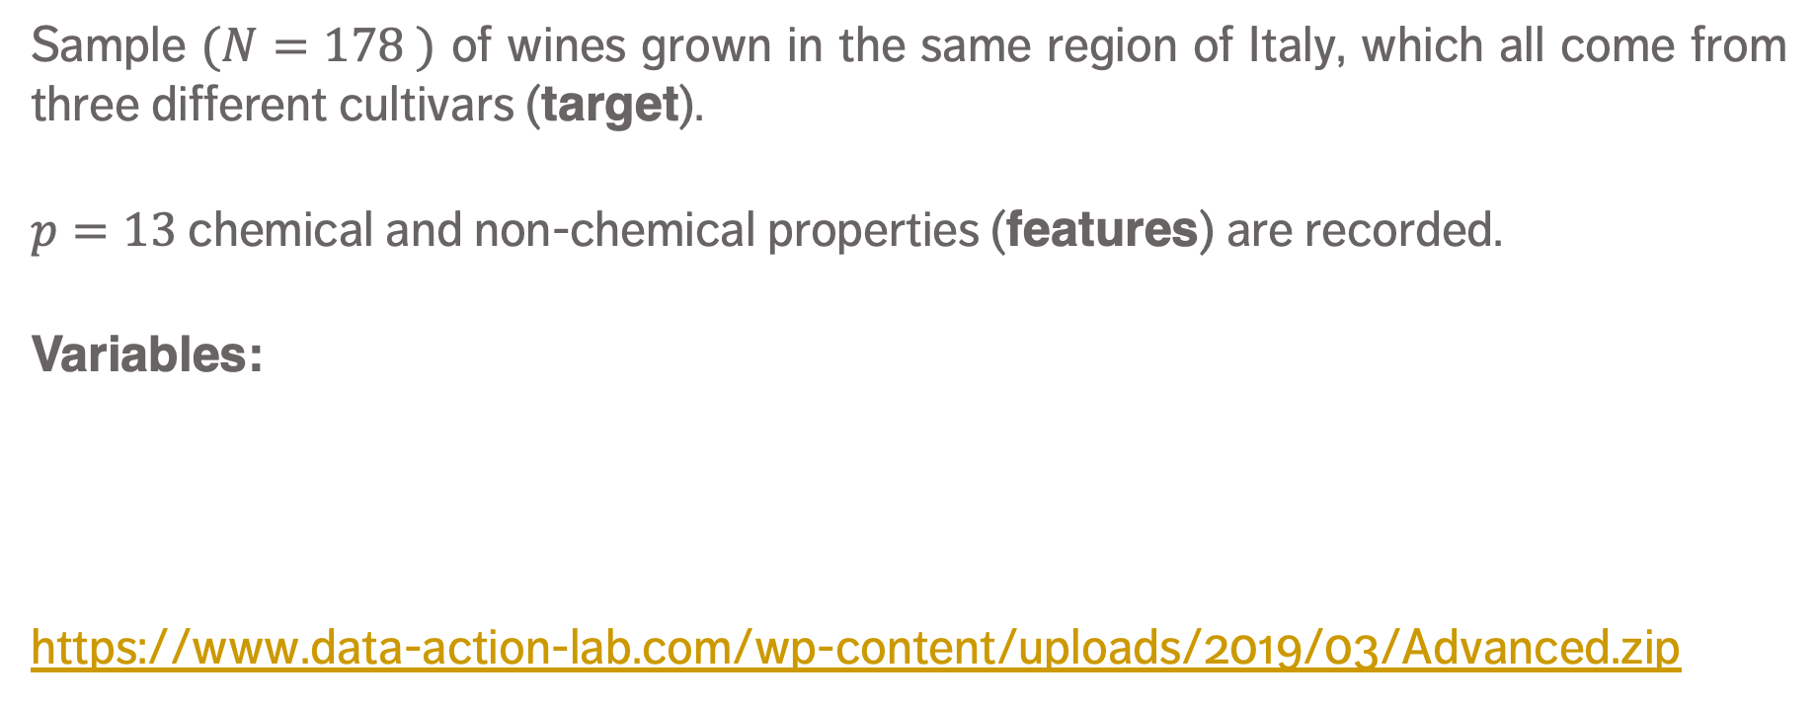
EXAMPLE – WINES Data
[https://archive.ics.uci.edu/ml/datasets/wine]
Sample $(N=178 )$ of wines grown in the same region of Italy, which all come from three different cultivars (target).
$p=13$chemical and non-chemical properties (features) are recorded.
Variables:
https://www.data-action-lab.com/wp-content/uploads/2019/03/Advanced.zip
alcohol
malic acid
ash
alkalinity of ash
magnesium
total phenols
flavonoids
non-flavonoid phenols
colour intensity
hue
OD280/OD315
proline

Slide 60
REFERENCES
ARTIFICIAL INTELLIGENCE AND NEURAL NETWORKS

Slide 61
References
Do Androids Dream of Electric Sheep?, the Guardian.
Neural Networks Demystified, Welch Labs.
Lawrence, S., Giles, C.L., Tsoi, A.C. (1996), "What size neural network gives optimal generalization? Convergence properties of backpropagation". Technical Report UMIACS-TR-96-22 and CS-TR-3617, Institute for Advanced Computer Studies, University of Maryland, College Park.
Elissee, A., Paugam-Moisy, H. (1997), "Size of multilayer networks for exact learning: analytic approach". Advances in Neural Information Processing Systems 9, Cambridge, MA: The MIT Press, pp.162-168.
Y. Bengio, Y. LeCun (2007), Scaling learning algorithms towards AI, in L. Bottou, O. Chapelle, D. DeCoste, J. Weston (eds), Large-Scale Kernel Machines, MIT Press
A Beginner’s Guide to Understanding Convolutional Neural Networks (part 1, part 2)
Fitting a neural network in R
Training and Visualizing a Neural Network With R

Slide 62
References
A Neural Network Playground
Neural Networks and Deep Learning
A Beginner’s Guide to Neural Networks With R!
Neural Networks, Manifolds, and Topology
Wikipedia entry for ANNs: https://en.wikipedia.org/wiki/Artificial_neural_network
C. Stergiou, D. Siganos, Neural Networks
Artificial Intelligence – Neural Networks
UFLDL Tutorial, Stanford University
The Neural Network Zoo, Asimov Institute
https://en.wikipedia.org/wiki/Reinforcement_learning

Slide 63
References
http://www.scmp.com/tech/enterprises/article/2095929/alphago-vanquishes-worlds-top-go-player-marking-ais-superiority
https://www.theguardian.com/technology/2017/jan/30/libratus-poker-artificial-intelligence-professional-human-players-competition
http://www.cbc.ca/news/canada/newfoundland-labrador/artificial-intelligence-robots-battle-memorial-university-starcraft-1.4298844
https://www.digitaltrends.com/cool-tech/japanese-ai-writes-novel-passes-first-round-nationanl-literary-prize/
https://futurism.com/a-new-ai-can-write-music-as-well-as-a-human-composer/
https://techcrunch.com/2016/09/01/this-trailer-made-by-ibms-watson-proves-ai-knows-how-to-creep-you-out/
http://www.bbc.com/news/health-36482333
https://www.digitaltrends.com/computing/cdc-flu-forecasting/

Slide 64
References
https://www.newscientist.com/article/2147472-ai-spots-alzheimers-brain-changes-years-before-symptoms-emerge/
Explaining and harnessing adversarial examples, I.J. Goodfellow, J. Shlens, C. Szegedy, ICLR 2015, https://arxiv.org/abs/1412.6572
https://arxiv.org/pdf/1710.08864.pdf
http://blog.ycombinator.com/how-adversarial-attacks-work/?imm_mid=0f81cc&cmp=em-data-na-na-newsltr_20171115
http://www.kurzweilai.net/
https://www.theguardian.com/technology/2014/jun/08/super-computer-simulates-13-year-old-boy-passes-turing-test
http://www.foxnews.com/tech/2016/03/25/microsoft-takes-tay-chatbot-offline-after-trolls-make-it-spew-offensive-comments.html

Slide 65
References
http://www.dailymail.co.uk/sciencetech/article-4747914/Facebook-shuts-chatbots-make-language.html
http://www-formal.stanford.edu/jmc/history/dartmouth/dartmouth.html
https://www.quora.com/What-is-the-Manifold-Hypothesis-in-Deep-Learning
No free lunch theorems for optimization, D.H. Wolpert, W.G. Macready, IEEE Transactions on Evolutionary Computation 1, 1997
https://www.inverse.com/article/29879-knock-knock-joke-humor-ai-neural-network
https://en.wikipedia.org/wiki/DARPA_Grand_Challenge (2005)
https://www.cnbc.com/2017/09/12/apple-unveils-a11-bionic-neural-engine-ai-chip-in-iphone-x.html
https://www.gizmodo.com.au/2015/09/this-neural-networks-hilariously-badimage-descriptions-are-still-advanced-ai/

Slide 66
References
https://www.gizmodo.com.au/2015/07/googles-neural-network-chatbot-can-discuss-philosophy-and-it-troubles/
https://www.gizmodo.com.au/2015/08/this-neural-network-is-hilariously-bad-at-describing-outer-space/
https://splinternews.com/these-bots-wrote-and-delivered-their-own-ted-talks-sor-1793848398
Universal adversarial perturbations, Seyed-Mohsen Moosavi-Dezfooli, Alhussein Fawzi, Omar Fawzi, Pascal Frossard, Oct 26, 2016, https://arxiv.org/abs/1610.08401
https://www.cnet.com/news/elonmusk-artificial-intelligence-world-wariii-russia-china/
https://www.technologyreview.com/s/546301/will-machines-eliminate-us/
https://www.technologyreview.com/s/609070/inside-the-moonshot-effort-to-finally-figure-out-the-brain/
Is AI riding a one-trick pony? MIT Technology Review, Sep 29, 2017, https://www.technologyreview.com/s/608911/is-ai-riding-a-one-trick-pony/

Slide 67
REFERENCES
Axios, Sep 15, 2017, https://www.axios.com/ai-pioneer-advocates-starting-over-2485537027.html
TechCrunch, Sep 30, 2017, https://techcrunch.com/2017/09/30/ai-hype-has-peaked-so-whats-next
Fortune, Jun 28, 2017, http://fortune.com/2017/06/28/ibm-watson-ai-healthcare/
https://stuff.mit.edu/people/mitter/publications/121_Testing_Manifold.pdf
https://colah.github.io/posts/2014-03-NN-Manifolds-Topology/
http://robots.stanford.edu/papers/thrun.stanley05.pdf
https://medium.com/@samim/generating-captions-c31f00e8396e
R. Kolakota, M. Robinson, D. Tapscott [1999], E-business 2.0: Roadmap for Success, Addison-Wesley
F.F. Reichheld [1993], Loyalty-based management, Harvard Review, March/April, pp.64-73
https://distill.pub/2017/aia/
https://distill.pub/2018/building-blocks/

